Slide 1
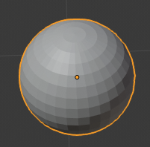

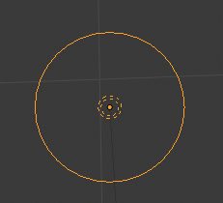


Linking mesh to light with custom properties
mesh
Associated light name
PointLight

Slide 2
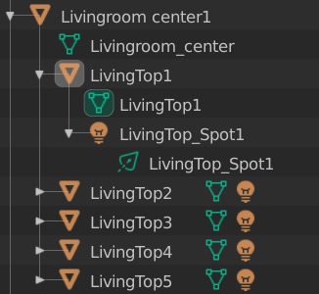
Linking mesh to light with scene structure

